Slide 1
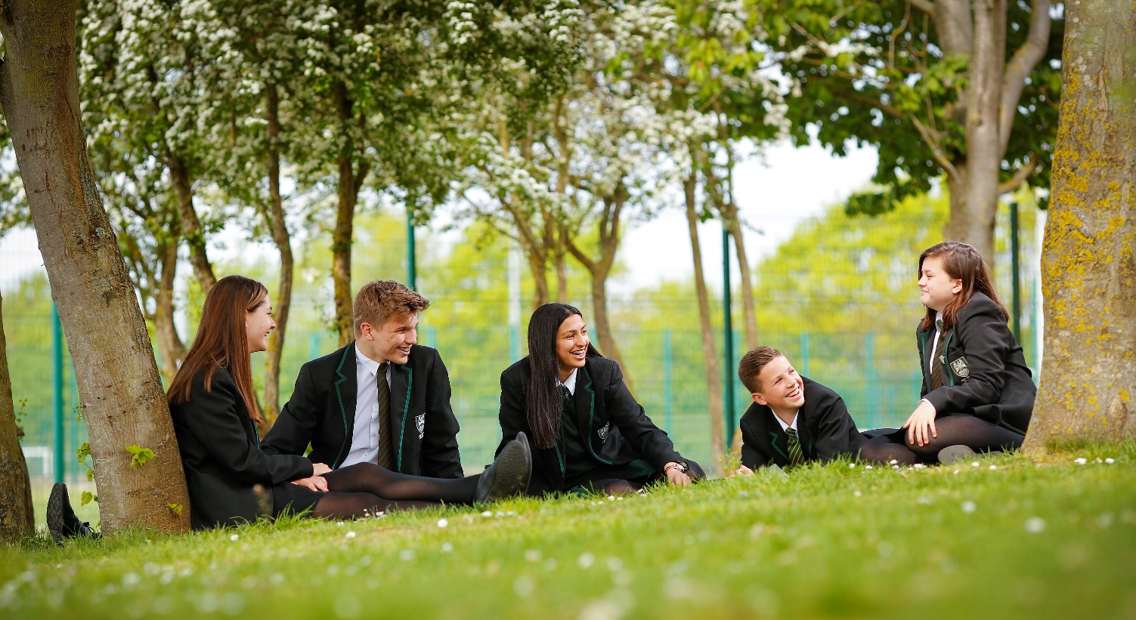
The Cox Green Way and Our Values
Mr Edwards Headteacher

Slide 2
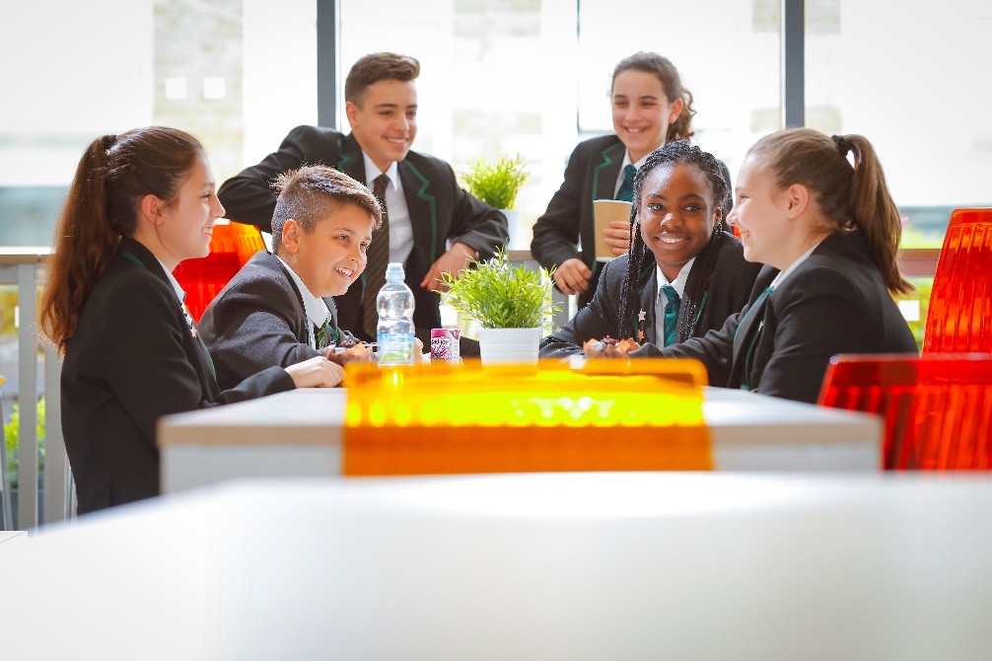
Values
Be Determined
Be Kind
Be Respectful

Slide 3
Vision
Cox Green is a community school proud of both its students and staff. Our values are at the core of all we do. Our ambition is that every member has the opportunity to realise their aspirations in an environment where they feel supported and safe.
Students’ progress from Cox Green as well-rounded citizens with the life skills required to be successful for their next steps.

Slide 4
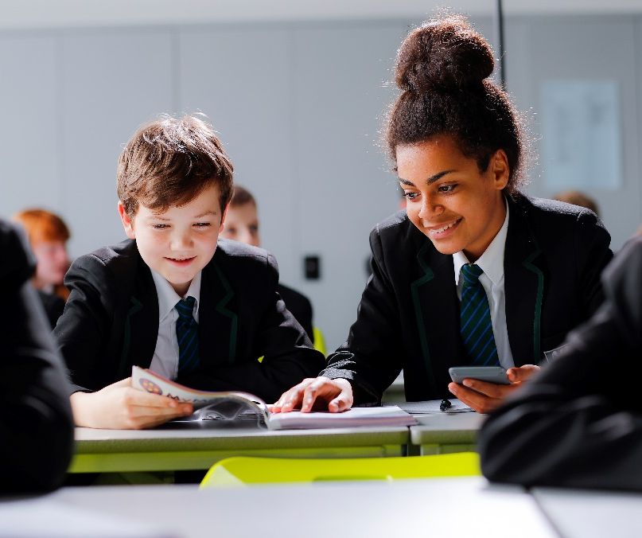
Culture of Success
Developing our students to be strong citizens of our school and community.
Establishing a culture where our students aspire to the very best they can be.
Embedding a curriculum that is broad, enriched, exciting and ambitious for all our students.
Enabling all students access to a positive teaching and learning environment meeting their needs.

Slide 5
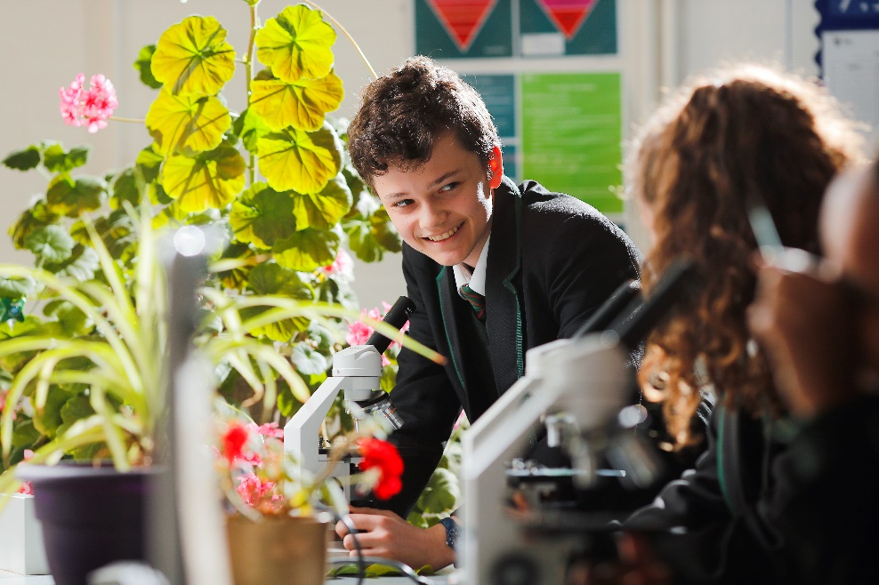
Curriculum: The building blocks for success
Building a curriculum to enable all to be successful.
Academic and Vocational offer at Key Stage 4 and 5.
Increase in offer for all students with the opportunity to pick subjects that meet their passion.
A strong study pathway.

Slide 6
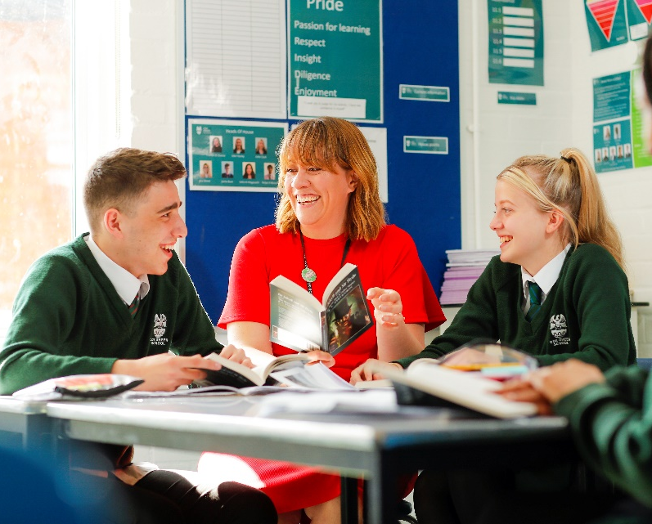
Numeracy and Literacy
Young people develop at different paces and our priority is to meet all the needs of our students at Cox Green.
Reading is a key element in all subjects and students are supported through transition and early in Year 7 to allow our staff to enable all students to progress.
Every child has potential and our job is to allow each and every child to flourish.

Slide 7
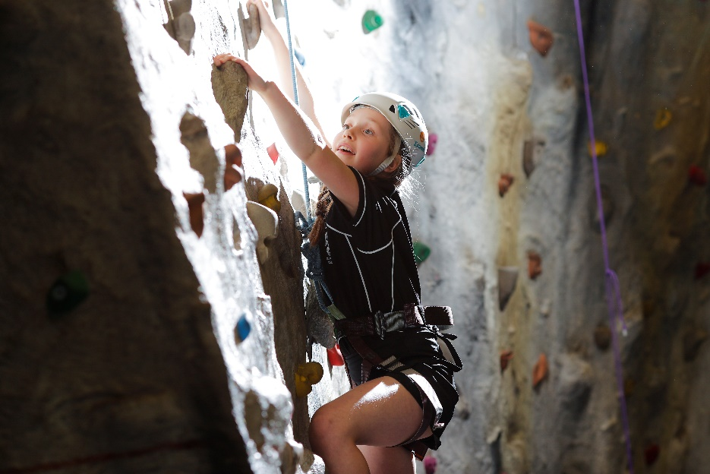
The Cox Green Way
Our wider curriculum allows students to understand and develop into well rounded citizens in our community.
Our personal development curriculum, clubs, trips and school events allow our young people to experience more than just the classroom.

Slide 8
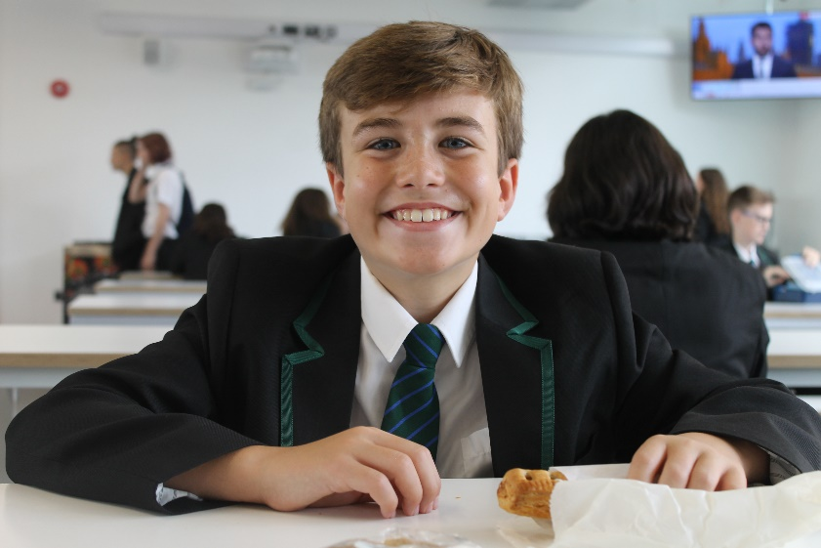
The Cox Green Way
Pastoral support – A unique support system that allows each group a designated SAFE manager, alongside a Head of Year and Form Tutor.
Strong community links – Cox Green is a pivotal part of our community and we pride ourselves on the impact our young people have locally.
Ambition – Our goal is to allow all to aspire to achieve the very best they can.

Slide 9
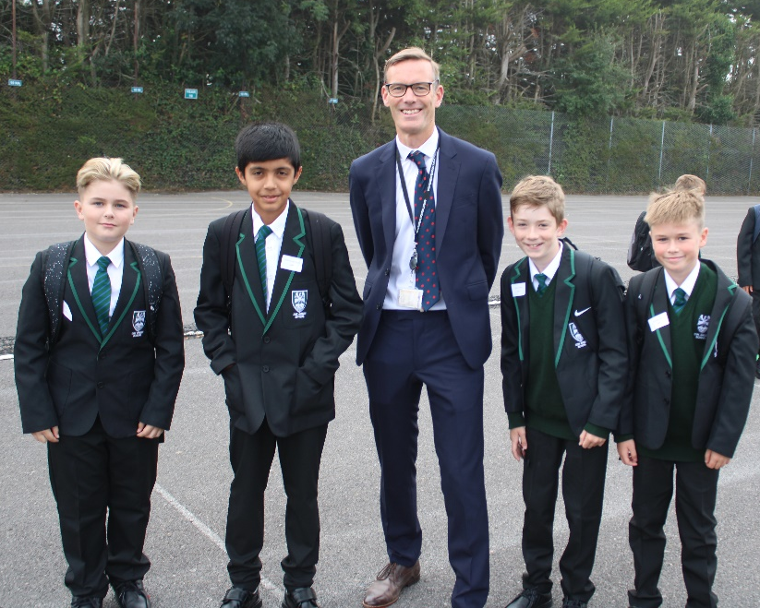
Year 7: The First Few Weeks at Cox Green
“All the pupils across the year groups have made me feel at home - I already feel part of the school community and I know this school will push me to be the best version of myself.”
Be Respectful Be Kind Be Determined

Slide 10
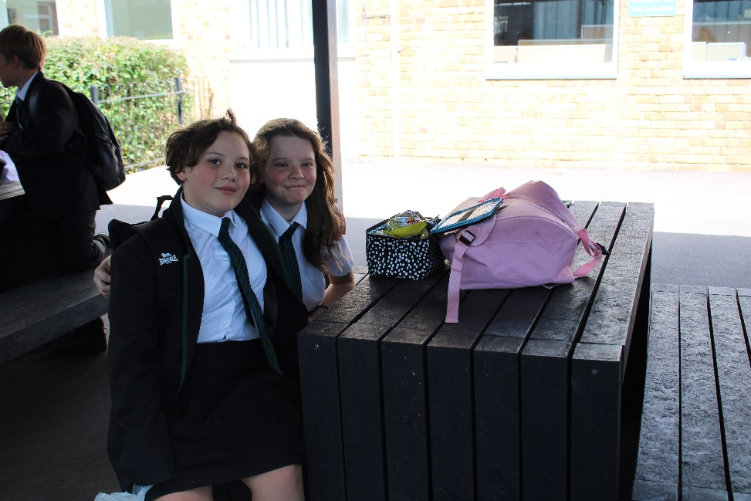
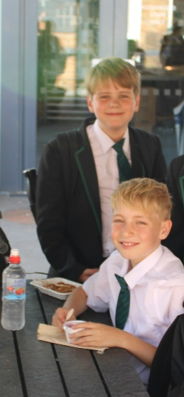
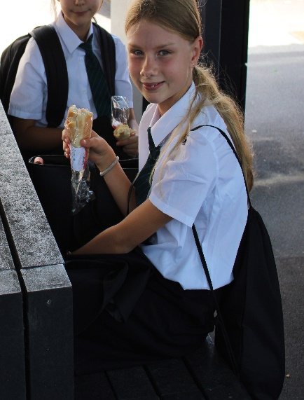
Year 7: The First Few Weeks at Cox Green
“I enjoy all the lessons, but I have to say that my favourite lesson is maths. This is my favourite because my teacher makes the lesson enjoyable”
‘Don’t be afraid to ask for help - everyone is so friendly and ready to help you!”’
Be Respectful Be Kind Be Determined

Slide 11


Connect with Us!
Keep up to date with us on Social Media.
Look for and like Cox Green School on Facebook
@CoxGreenSchool on Twitter
.
Be Respectful Be Kind Be Determined

