Slide 1
Welcome to Cox Green School
Induction Evening 2023

Slide 2
Learning and progress for all at Cox Green
Teachers adapt their lessons to ensure that all students are suitably challenged.
Students are supported in their learning to allow all make the best progress possible which includes scaffolding and stretch tasks.
Students learn to work together and independently to build interdependence and collaborative skills.
Our curriculums are designed to ensure that students are prepared for the world of work and develop skills beyond the academic.
.

Slide 3
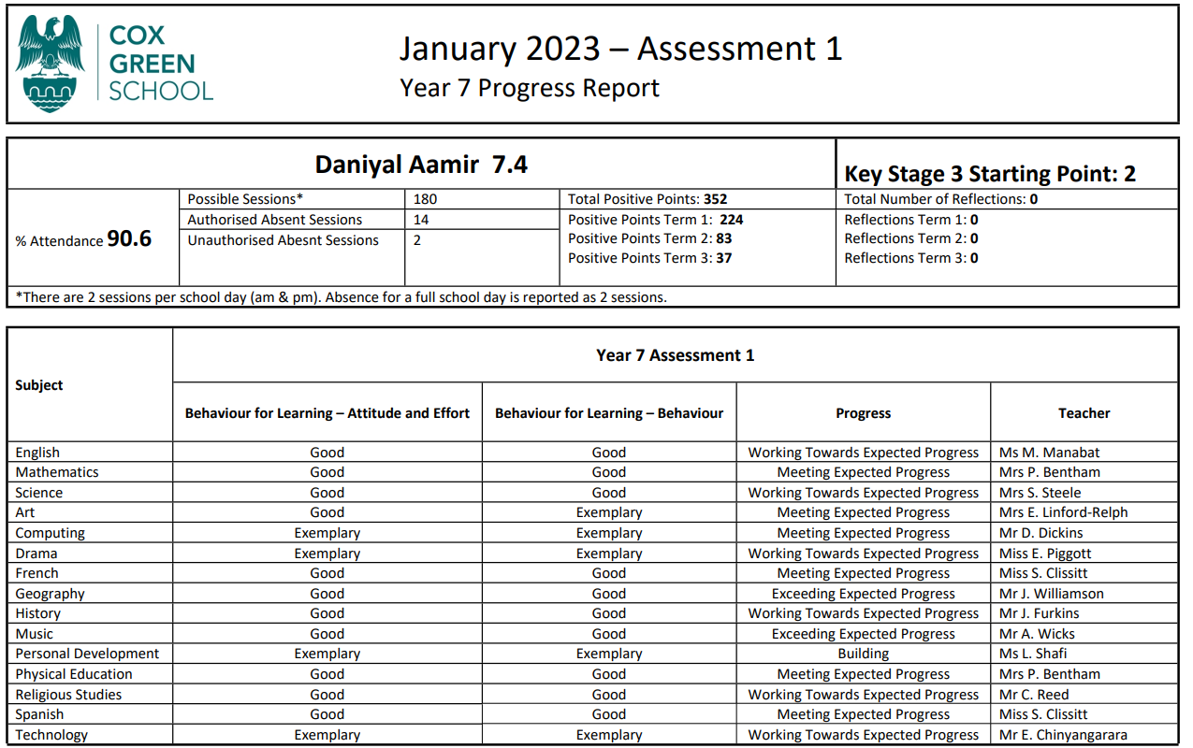
Assessment & Reporting
“Aim is to focus on providing clear guidance to students about how effective their learning is and also what they need to improve through accurate assessment & feedback.”
Assessment Point 1 - Post-Christmas holiday - Based on December assessment week results and all relevant work up to this point
Assessment point 2 - July - Based on summative assessments and all relevant work up to that point, including summer assessment week results
Progress is calculated taking all evidence into account, against pupil’s staring point.
KS3 SP | CAT score | Indicative GCSE target Range​
4​ | 115+​ | 7 - 9​
3​ | 105 to 114​ | 5 – 7​
2​ | 86 to 104​ | 4 – 5​
1​ | Below 85​ | 1 – 3​

Slide 4
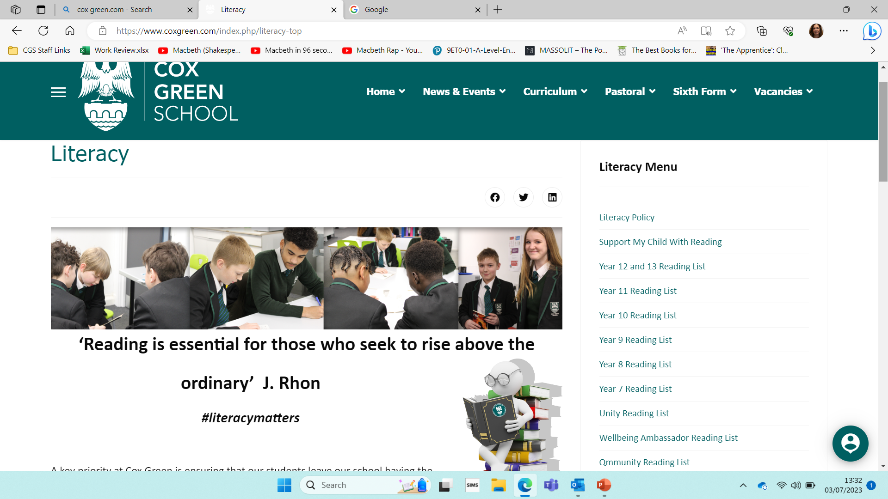
#literacymatters
Reading is a key element in all subjects and students are explicitly taught a range of reading strategies to support them with comprehension, analysis and evaluative skills.
All students are expected to have a reading book as part of their equipment. Students read regularly with their English teachers and complete reading challenges throughout the year.
Students will also complete reading tasks for homework set on Teams.
To support this, our literacy page has comprehensive reading lists and a section which supports parents/carers in developing their child’s reading skills.

Slide 5
Home learning: develops independence and organisational skills
Home learning tasks range from creative projects, research tasks, reading, writing and the use of on-line platforms.
All home learning tasks are designed to build on skills, knowledge and understanding taught in lessons.
Home learning is set on teams and linked to EduLink for both parents and students to access.
Homework club is available to support our students.

Slide 6
Role of the tutor
They are LOCO PARENTIS
Your child be able to get involved in a range of house competitions throughout the year in different subjects.
They will register every morning with their tutor and their tutor is the first point of contact.
They will do Personal Development (PD) sessions once a fortnight where they will explore the wider world, RSE and health and wellbeing.
They will have an assembly each week which picks up key themes of the school values, PD, British Values, Protected Characteristics and important events.

Slide 7
The tutor programme
Monday | Tuesday | Wednesday | Thursday | Friday
Tutor Catch-up, equipment check and notices for the week | Literacy | Wellbeing Wednesday | Numeracy Ninjas | Assembly
Every fortnight they will have a PD lesson instead of one of their timetabled lessons – their tutor will let them know when these are taking place, or you can check the website.
There is a PD Newsletter which comes out at the start of each term with news and information.
Notes:
Check this is the correct way round

Slide 8
The School Day
Time | Activity
8:30 – 9:00 | Tutor time
9:00 – 10:00 | Lesson 1
10:00 – 11:00 | Lesson 2
11:00 – 11:30 | Break 1
11:30 – 12:30 | Lesson 3
12:30 – 13:30 | Lesson 4
13:30 – 14:00 | Break 2
14:00 – 15:00 | Lesson 5
We have a 2-week timetable so you will have slightly different lessons each week.

Slide 9
Expectations of tutor time
Arrive on-time
Make sure they have the correct uniform:
Ensure their uniform is clearly marked with their full name and tutor group
Try to support them to get organised the night before.
Make sure they have all their equipment:
Aim for 100% attendance
There are awards and competitions throughout the year linked to attendance and punctuality.

Slide 10
Developing personally
Encourage your child to make the most of the opportunities available get involved in some of the extra-curricular activities.
These run at break 1 and break 2 as well as after-school.
You can see the timetable of activities on the school website and sign-up using edulink.
Students will have opportunities to go on trips and visits so try to make the most of these.
There are groups to support issues around wellbeing, racism, homophobia and bullying.

Slide 11
If you need support:
Your child will see their tutor every morning so they are the best person to support you.
If you have any concerns please speak to your childs’ tutor, teacher or the SAFE team.
There is also the email address beheard@coxgreen.com
There are student groups for a range of interests that support and provide opportunities including Qmmunity, Unity, Wellbeing Ambassadors, JSL, Prefects, Anti-bullying group, sport, music, drama and others.
Information on outside agency support groups are provided within PD and Wednesday Wellbeing and as needed.

Slide 12
Values Card
VALUES CARD
Positive signatures Prize draw
Reasons for signatures
.Being Kind
.Being Respectful
.Being Determined
Values Cards:
In September students will all be provided with a values card – they must keep this on them at all times.
These are for staff to recognise positives and issue sanctions outside of lessons.
Students can earn signature for both positives and negatives:
Name
Tutor
Date

Slide 13
Key Staff
Deputy Headteacher (Pastoral) – Mrs Morgan-Russell
Assistant Headteacher in charge of KS3 – Miss Hughes
Head of Year – Miss Piggott
Designated Safeguarding Officer – Mrs Phelps
SAFE Manager for Year 7 – Miss Last
SENDCo – Mrs Brennan
Behaviour Support Manager – Miss Middleton
Form Tutor
Attendance Officer – Miss Cottington

Slide 14
Headteacher – Mr Edwards
Be Determined
Be Kind
Be Respectful

Slide 15
Journey
Year 7 – 13 – Different pathways but all have the opportunity.
Cox Green is a community school proud of both its students and staff. Our values are at the core of all we do. Our ambition is that every member has the opportunity to realise their aspirations in an environment where they feel supported and safe. Students’ progress from Cox Green as well-rounded citizens with the life skills required to be successful for their next steps.

Slide 16
Culture of Success
We are committed to achieving our vision by establishing a culture of success, focusing on the following priorities:
Developing our students to be strong citizens of our school and community.
Establishing a culture where our students aspire to the very best they can be.
Embedding a curriculum that is broad, enriched, exciting and ambitious for all our students allowing all students the opportunity to follow their chosen study pathway.
Enabling all students access to a positive teaching and learning environment meeting the needs of all our students.

Slide 17
Thank you for attending and we look forward to welcoming your children in September.

