Slide 1
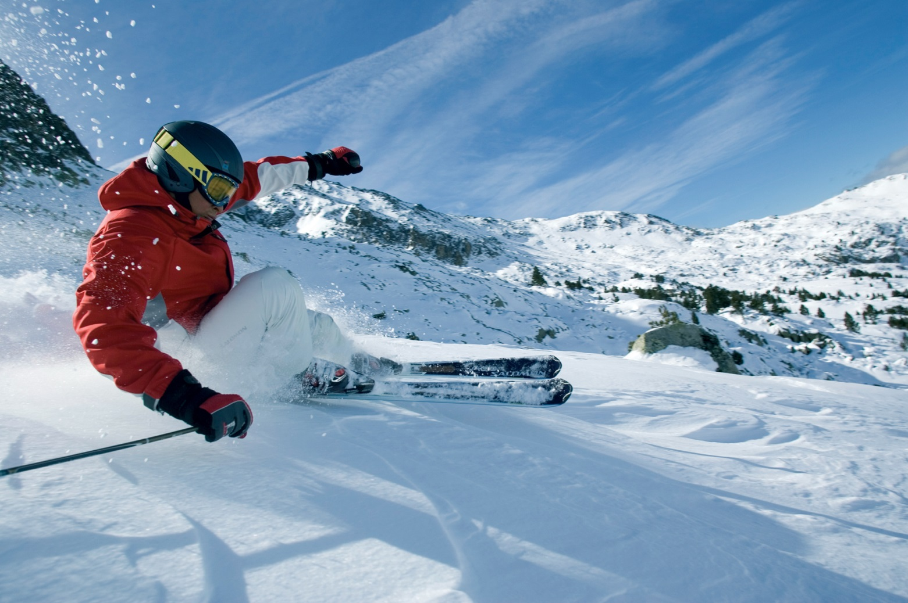
Andorra Ski Trip Saturday 11 – Sunday 19 February 2023

Slide 2
Why are we doing this trip?
To give students the opportunity to take part in an activity they may not otherwise experience
Cultural experience
A fun and memorable week away for all
Exhilaration and enjoyment
Developing confidence and self esteem
Introduction to new leisure activity
Development of social skills
Different/more mature relationships with teachers and other adults

Slide 3
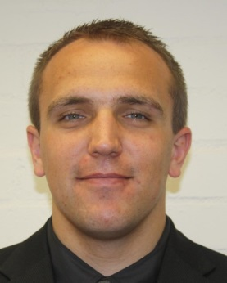
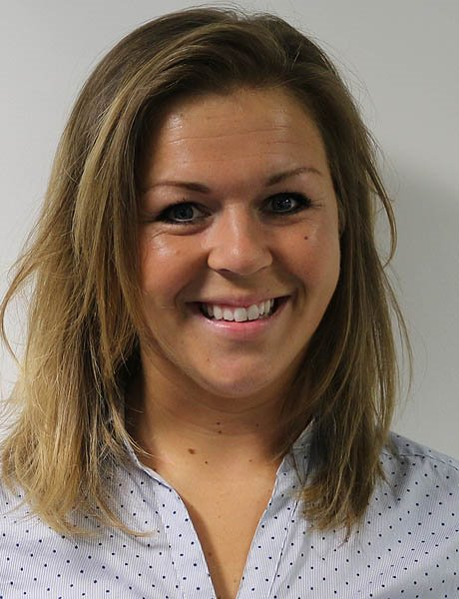
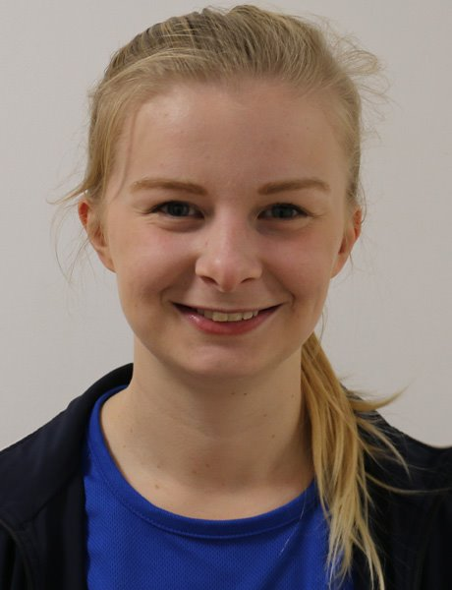
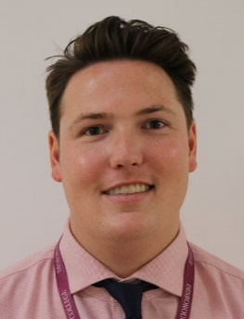
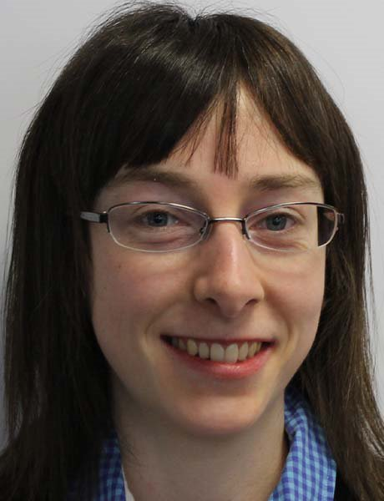
Staffing
Mr Morris
Trip Leader
Miss Killick
Deputy Trip Leader
Miss Beech
Mr Shand
Mr Lynch
Miss Winchcombe
Mr Thompson

Slide 4
Where are we going?
Maidenhead
Vallnord, Andorra

Slide 5
Accommodation
Hotel La Solana
Students will stay in multiple
bedded rooms (single beds)
Staff will be located in the same
area
Students to complete Student
Rooming Preference Request form

Slide 6
Saturday 11 February 2023
3.00pm Arrive at school, load luggage and
passport check
(please make sure you have your own passport and EHIC/GHIC card)
3.30pm Coach departs for Dover
(no chewing gum, nuts or chocolate on the coach)
6.00pm Arrive at Dover
8.00pm Ferry crossing to Calais
(arrives 22:30 local time)
All timings are to be confirmed.

Slide 7
Sunday 12 February 2023
2.30pm Arrive at Hotel La Solana and check in
Welcome meeting and briefing session with Tour Representative
4.00pm Arrive at resort
Ski/boot fitting
Evening meal at hotel

Slide 8
Monday 13 – Friday 17 February 2023
Breakfast in hotel
Walk to the slope (200m away from the lift)
Morning Skiing
Lunch Hot lunch on the slopes
Afternoon Skiing
Dinner Evening meal at hotel

Slide 9
Evening Activities
Three evening activities will take place.
These are likely to be:
Bowling
Burger/Pizza meal at a local restaurant
Shopping in Andorra La Vella
(These activities are to be confirmed and for which date/time)

Slide 10
Saturday 18 February 2023
Check out from rooms
Breakfast in hotel
Morning Skiing
Lunch Hot lunch on the slopes
Afternoon Skiing
Return ski equipment
(time to shower and change in rooms made available)
Evening meal at hotel
7.30pm Load coach and depart

Slide 11
Sunday 19 February 2023
12.00 noon Arrive Calais
2.00pm Ferry crossing to Dover
5.30pm Arrive back to school (approx.)
Students are expected to be in school on Monday

Slide 12
What’s included?
- In-resort meals – breakfast, lunch and evening dinner
- Cost of coach and ferry
- All day time (ski lessons) and evening activities
- Ski lift passes
- Ski, boot, pole and helmet hire
Students to provide own packed dinner/drinks for travel
day on the Saturday, or money to purchase food.
Students will need to purchase food/drinks for return journey.

Slide 13
Spending Money/Valuables
Students will hold onto their own spending money (Euros in resort and Sterling in England)
Students are advised against taking any valuable/personal items. Lost or stolen items cannot be replaced by the school and are not covered by school insurance. Parents/carers may want to take out their own cover.
Due to the nature of activities – NO JEWELLERY
(necklaces, earrings/piercings, watches)
Smoking/vaping and drinking alcohol (and purchase of) are strictly forbidden

Slide 14
What to take?
See suggested kit list in your envelopes.
Please ensure your own clothing is labelled.
Students must be able to carry their own luggage.
Soft holdall rather than hard case is preferable.

Slide 15
Emergency Contact
Follow updates via Twitter - @CoxGreenSchool
For emergencies only, please use the emergency number provided (this will be issued the week of the trip)
Parent/Carer
SLT (Senior Leadership Team)
Mr Morris
Student

Slide 16
Forms to check and sign
Check your personal contact details sheet (OA4) is accurate, as these are the details used should we need to contact you. Please clearly mark any amendments and return to Mrs Feetham in the Student Services Office by Monday 16 January 2023, or hand in now before you leave.
Please complete the ‘Overseas Medical and Behaviour Agreement’ and return to Mrs Feetham, by Monday 16 January 2023 (a week on Monday) or hand in now before you leave.

Slide 17
Medicines
Complete Residential Medicine Form for ANY medication your child requires for the duration of this trip
Any medication (prescribed or over the counter) is to be handed in to Mrs Feetham by Wednesday 8 February 2023 in original boxes and clearly labelled. Only provide enough medication for the duration of the trip.
Students are NOT to carry any medication (either prescribed or over the counter), the only exceptions are asthma inhalers or auto-injectors (a form must still be completed to detail this)
Trip Leader will hold onto medication listed on the Residential Medicine Form and dispense as directed
Complete Permission to Administer ‘Over the Counter’ Medication form and return by Monday 16 January (or hand in now before you leave)

Slide 18
Expectations and Code of Conduct
You will be representing the school on this trip.
International school trips and skiing are high risk activities. Positive behaviour is a must. We expect you to demonstrate excellent standards of behaviour.
As we are in a country that is unfamiliar, it is essential that you listen to and follow all instructions to make sure you have a fun and safe time on the trip.
Poor behaviour choices could result in:
- Loss of après ski
- Phone call to parents/carers
- Loss of ski time (after discussion with SLT)
Not skiing is not an option.

Slide 19
Ski Way Code
https://www.youtube.com/watch?v=NeS3ZRhemP4

Slide 20
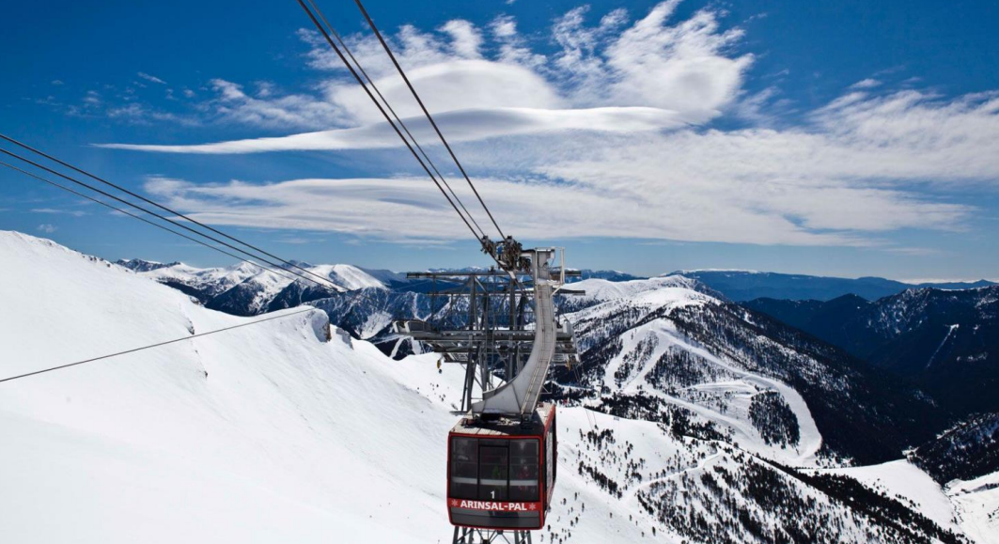
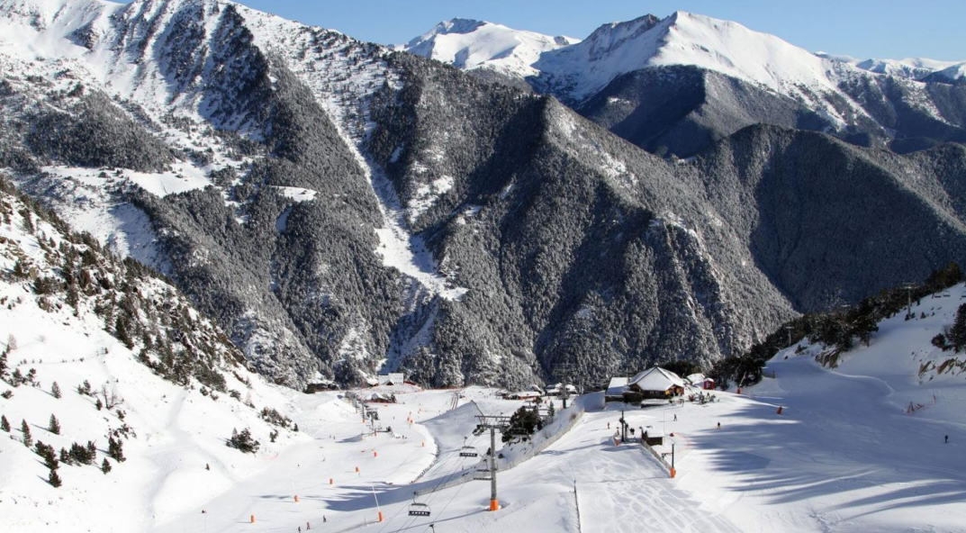
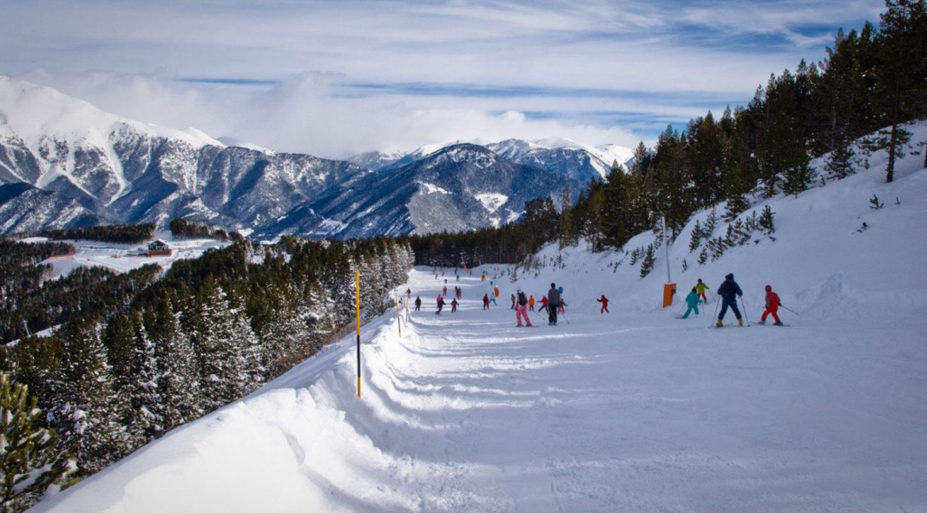
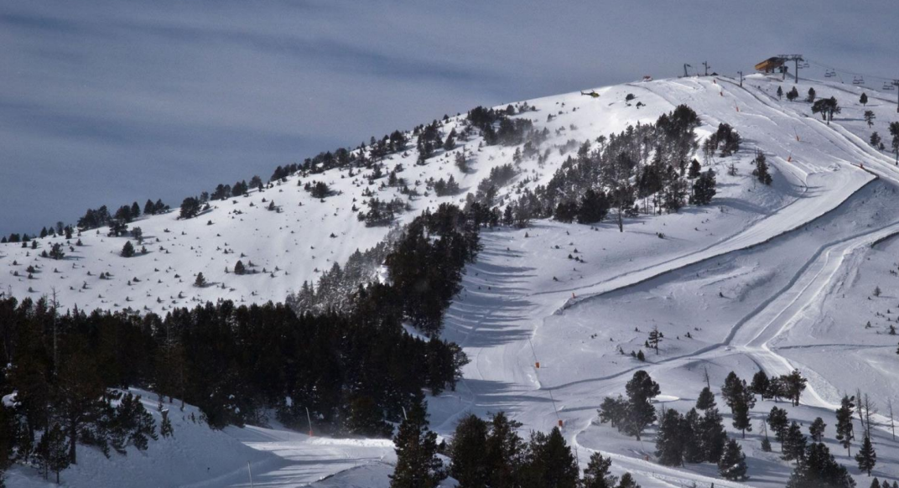
Any questions?

